Slide 1
Notes:
Facilitator to:
Welcome
Introduce presenters
Invite participants to join you in karakia to officially open the session
Use of Māori terms for child/children and young person
Setup/preparation:
Ensure that for the session you have lots of information on ICA, reading list, financial support, NGO information AND application packs available for participants
Housekeeping:
Bathrooms, water, coffee and tea
If the fire alarm sounds, we will exit the building through the emergency exits
If there is an earthquake, remain in the room and ‘Drop, Cover, Hold’
Please switch your phones to silent mode
Please respect any person who is talking
Questions are welcome at any time

Slide 2
Notes:
Note:
There may be questions as to why we start with a karakia. Ensure you are aware of the reasons we commence with this.
Remember this is on the OT app

Slide 3
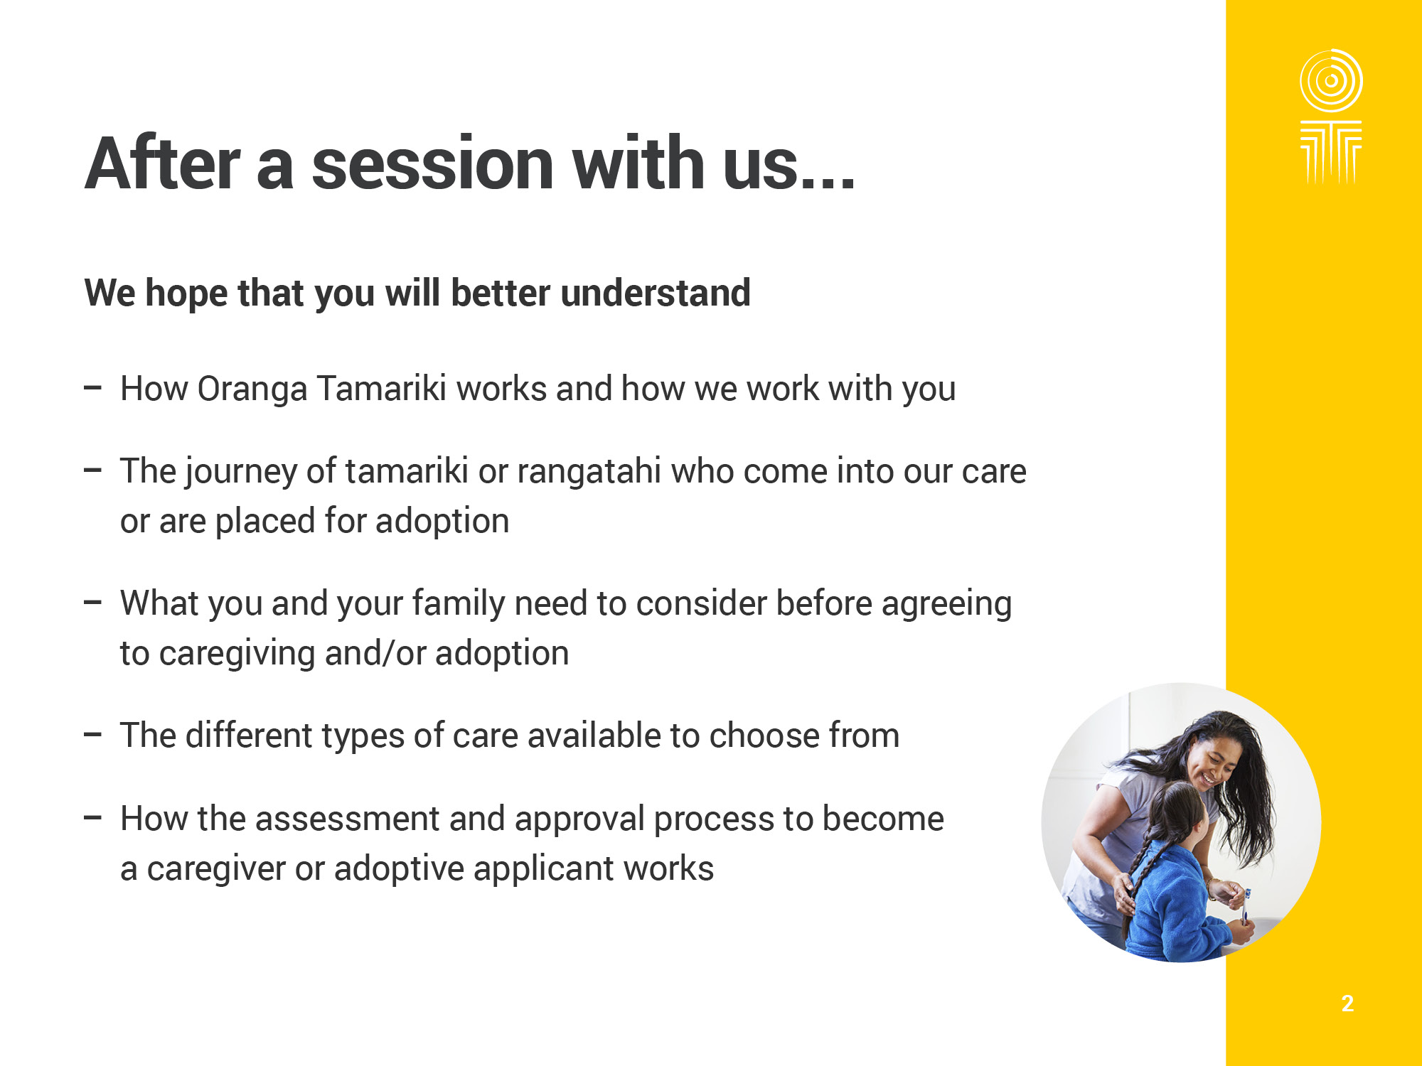

Slide 4
Notes:
Note:
'Oranga' is the wellbeing we want to help the children we work with to have.
'Tamariki' reminds us that children are descended from greatness. They are born with an inherent mana that can be damaged by abuse and neglect.
We support children, family and whānau to restore their mana, their sense of self, their important connections and relationships, their right to heal and recover, and reach their potential.

Slide 5
Notes:
Facilitator to:
Play video by clicking the image: https://www.youtube.com/watch?v=sniv1kHnzjk

Slide 6
Notes:
Note
Please remember to talk about the fact that children have told us they want to maintain connections to their whanau and culture.
We also have obligations under Section 7AA of the OT Act.

Slide 8
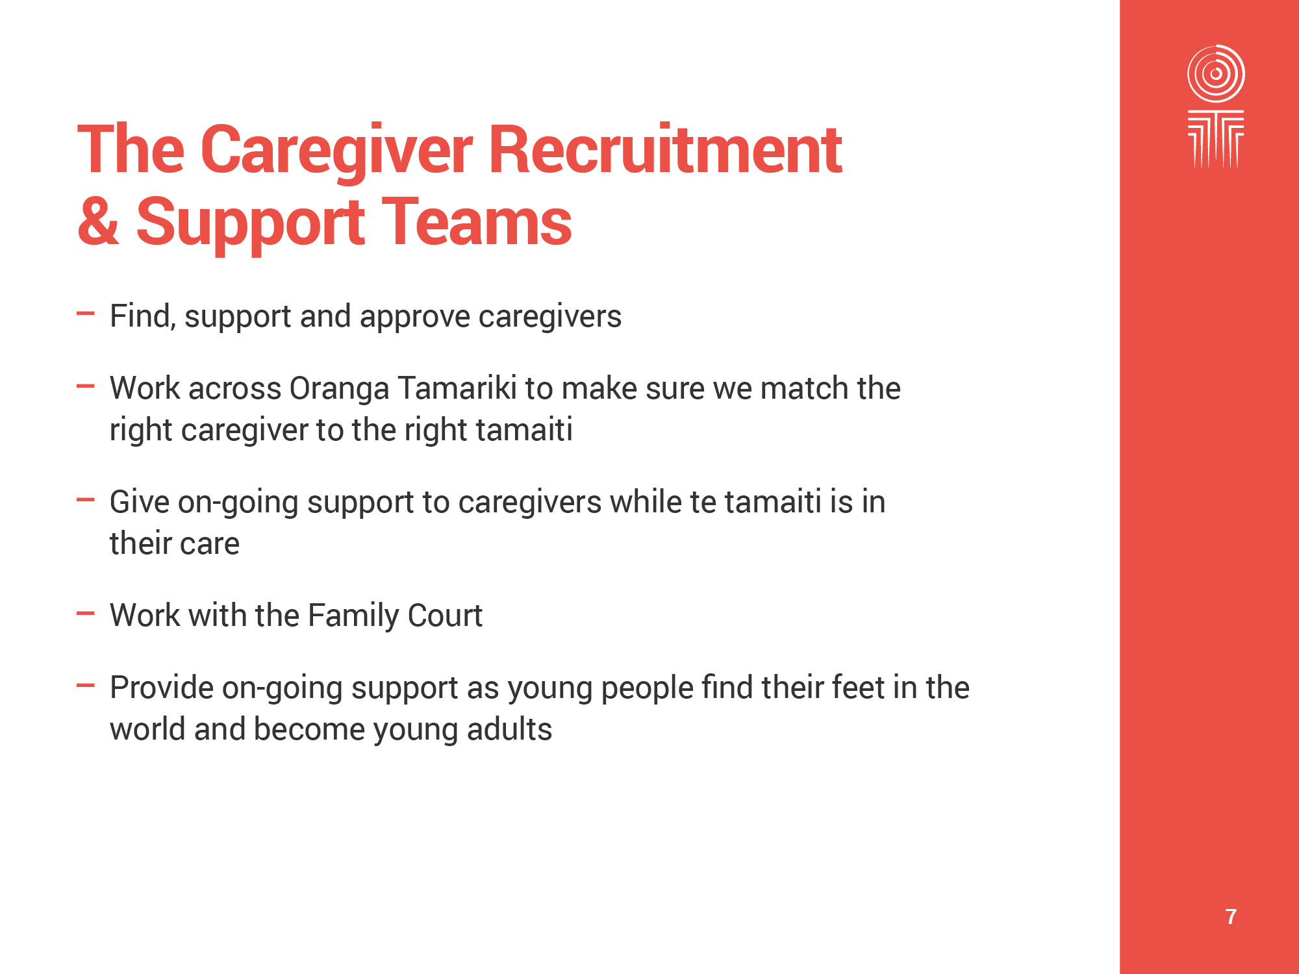
Notes:
Note
Just explain what the CGRS team does

Slide 9
Notes:
Note
Just explain the role of the Adoption Teams

Slide 10
Notes:
Note
An adoption in the Family Court is needed in order to establish a legal relationship between the child and their intending parents.
The fact that an adoption is needed might be an irritation for the adults; it is really important for the legal security of the child.

Slide 11
Notes:
Facilitator note:
As our legislation changes are further confirmed, we will update the slides and facilitator notes accordingly.

Slide 12
Notes:
Facilitator to:
Play video by clicking on the image: National Care Standards – https://www.youtube.com/watch?v=fbA2Jg5nbQo

Slide 14
Notes:
Facilitator to:
Explain reasons
Explain issues
Further to point 1:
Legally, they cannot do this until a minimum of 12 days after the birth.
Once consent is signed the social worker will issue the Social Worker’s Approval and the adoptive parents can then take the baby home and start to care for the child.
Within one month, adoptive parents should then make an adoption application to the family court.
Once the interim order is granted, adoptive applicants will have the role of providing day to day care for the child.
Once the final order is granted all parenting rights and responsibilities are transferred from birth to adoptive parent(s).
Further to point 3: There is often an on-going connection with the birth family and connecting with their culture is encouraged.
Further to point 4: This can include the birthmother, birthfather, and your own legal fees e.g. up to three times.

Slide 15
Notes:
Facilitator to:
Explain reasons and issues
Facilitator note:
New Zealand has adoption agreements with 7 countries, and these are the ONLY countries that you can apply to adopt an unknown child from.
Intercountry adoption is a lengthy process and matching and wait times vary. It is managed between the Central Authorities of NZ and that Country.
In all cases, the adoption must conform with the Hague Convention.
You have a choice of who you work with for your assessment:
Oranga Tamariki: Assessment is free. Costs include medical and psychological reports; legal fees; translating, authenticating documents and all travel costs; some countries also have a set fee.
Adoption First Steps: Fees apply for assessment.
Once your assessment is completed additional documentation and processes can be facilitated by:
Oranga Tamariki, Inter-country adoption New Zealand, and Compassion for Orphans.
Oranga Tamariki do not charge fees for processing.
You should follow up with other organisations as to their costs.
Additional notes:
Children may have been removed from family permanently, abandoned, or voluntarily relinquished. All are in state care, often in an institution or an orphanage.
You cannot adopt a child directly from an orphanage. Intercountry adoption is a process. It is managed between the Central Authorities of NZ and the sending Country.
Intercountry adopted children will have experienced disrupted care histories and backgrounds involving separation, loss, abuse and neglect, and are impacted by trauma.
In addition to the loss of their family, and homeland when moving to a new country children have cumulative losses including, orphanage staff and friends, language, and culture.
Each country has its own requirements of adoptive parents, and their own adoption and legal process.
There are different court or other processes required by each country before the adoption is concluded. These may need to take place in the child’s country of origin.

Slide 16
Notes:
Note:
We care for thousands of tamariki /children and rangatahi/young people to keep them safe and make a positive difference in their lives.
Any person who is concerned for a tamaiti/child, or rangatahi/young person can make a report of concern.
A social worker undertakes an extensive safety assessment for the tamaiti/child.
Wherever possible tamariki/children remain in the safe care of their immediate family. When this is not possible extended whānau/family options are considered.

Slide 17
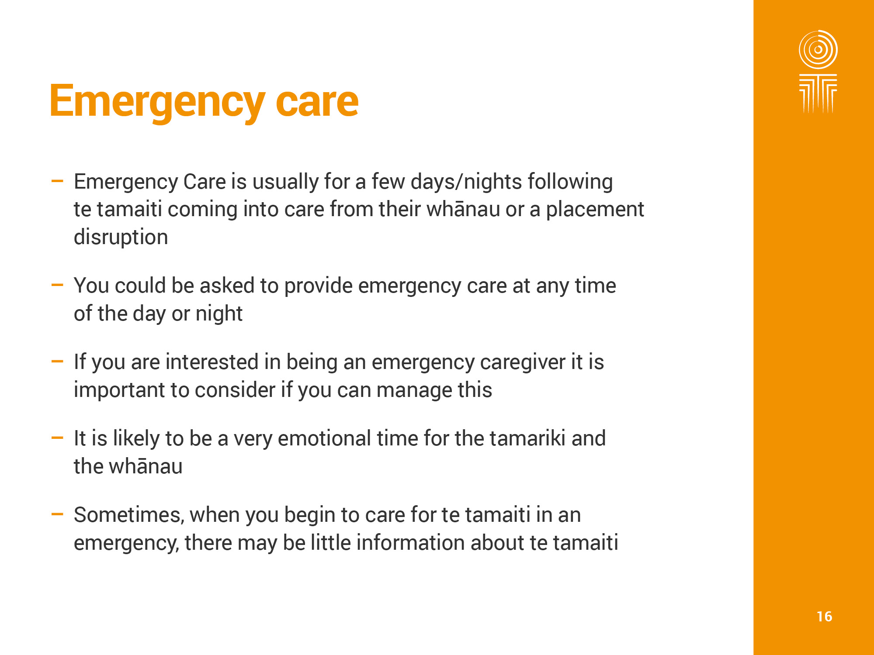

Slide 18
Notes:
Note
Respite care works best when it is linked to children’s natural networks – whanau and friends – as opposed to strangers who the children don’t really know that well
This came through the EAP report research with children being seen to be moved around to the adults a break with little regard to the children.
Therefore using the networks that the children have often works well

Slide 19
Notes:
Note:
Lorena is 6 years old.
She has been in care since she was 3 years old.
When Lorena first came into care she was placed with her maternal grandmother.
When Lorena was 5, her grandmother became ill and she was placed in the care of her aunt and uncle.
Whilst in their care, Lorena was abused.
For the past 7 months, Lorena has been living with a transitional caregiver whilst the Ministry searched for whānau to care for her.
Lorena is quiet and reserved, and struggles with making friends. Right now, she is finding it difficult to trust the adults in her life.
Note: “quiet and reserved” - could be personality or internalising

Slide 20
Notes:
Notes:
Just like if you have other children in the home you need to consider the impact of another child coming into the home and what behaviours your whānau/family would be able to cope with.
Voluntary and involuntary – usually if there is a care and protection concern then there would be no family visiting the caregivers home as this may place the child, caregiver and/or family at risk, however with adoption it is a voluntary process and there isn't usually a care and protection component so birth parents and prospective adoptive parents may visit. This would be discussed with the social worker.
If the child you are caring for becomes available for permanent care, this does not automatically place you as their permanent caregiver. You will be assessed for a different type of care.

Slide 21
Notes:
Facilitator to:
Play video by clicking on the image: https://www.youtube.com/watch?v=NjDf_QEPbsM
Discuss the importance of maintaining whanaungatanga and mana tamaiti use the video as a discussion point

Slide 22
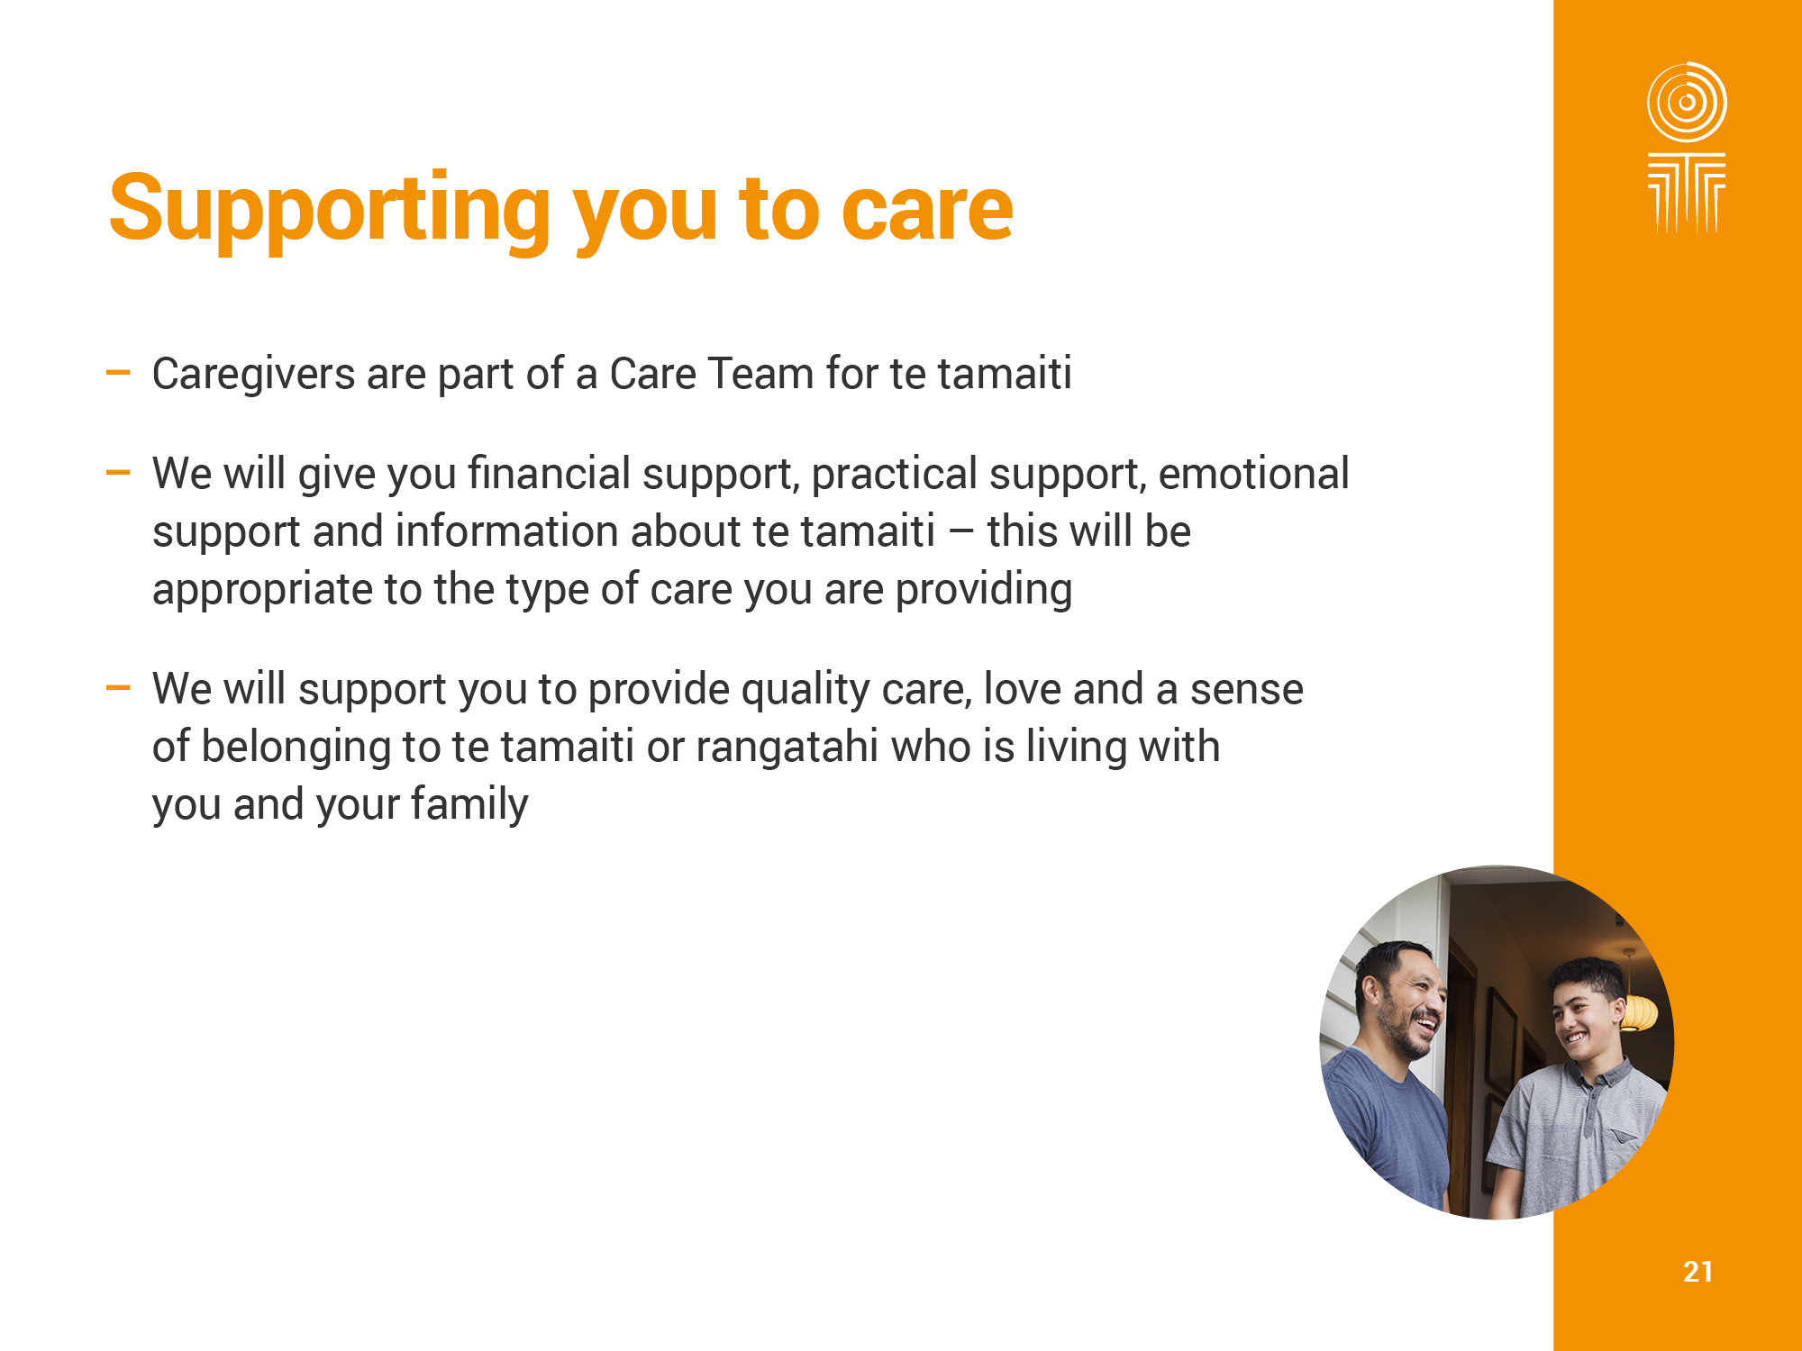
Notes:
Note:
You will receive a non-taxable foster care allowance (also known as board payment) from the time a child or young person comes into your care.
This is to help you cover the everyday care costs of having a child in your home, such as their food, household costs, general transport and all the other opportunities and experiences you’ll give them as part of your family.
How much you receive is based on the age of the child and is adjusted each year. This will be paid directly into your bank account each fortnight.
Explain practical support available e.g. respite, training
Need to mention other entitlements - set up grants, travel costs etc.
Weave in the Care Stds for example - support with meeting educational needs and cultural connection – Stds 62.63 etc

Slide 23
Notes:
Note:
Continue from the previous slide

Slide 24
Notes:
Facilitator to:
Play video by clicking on the image: https://www.youtube.com/watch?v=gtQkcSI48fQ

Slide 26
Notes:
Note:
Wiremu is 9 years old.
He was 5 years old, with non-accidental injuries by his stepfather.
When he came into care, it was discovered that Wiremu has been living a transient life with his mother and has had very little schooling.
Wiremu is at the developmental level of a 5 year old, has been known to lash out at caregivers and has smashed things around the house when he has become uncontrollable. He has also run away from school on a number of occasions and can be difficult to reason with.
Wiremu has been living with a caregiver who has made some great progress with him, now attending school regularly and he has also joined a soccer club.
Attempts have been made to return Wiremu back to the care of his mum. However, she has not been able to do create a safe home.
The permanent care plan is for Wiremu to be placed with his aunt in Tauranga and the Ministry is currently in the process of working with the whānau for this to happen.

Slide 27
Notes:
Facilitator to:
Explain that they will remain as the caregiver and they are not the parent i.e. guardianship
Give examples of guardianship decisions

Slide 28
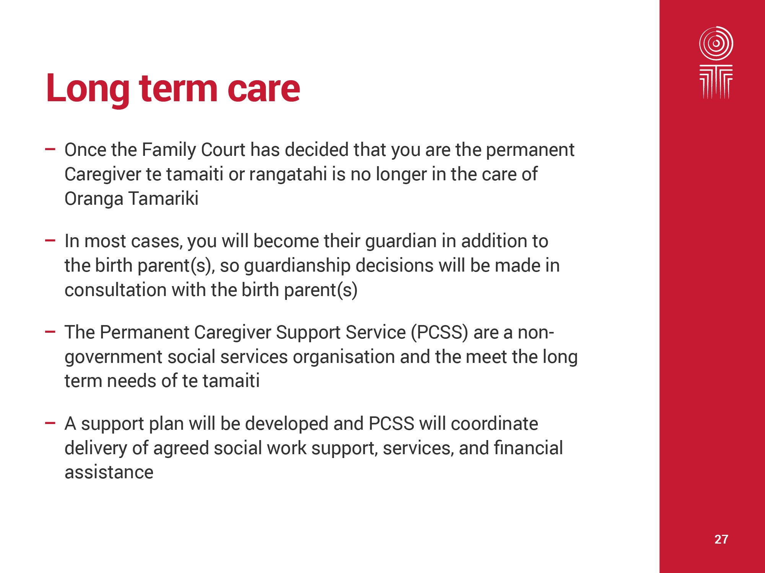

Slide 29
Notes:
Note:
What we do know is that children we work with have encountered a range of experiences BOTH those in care, and those who are adopted.
This trauma may have influenced their development, how they relate to people and behaviour and can present differently depending on the experiences the child has had.
When considering the world of the child the child will require more time, more engagement, more effort, more intentional responses in order for children to reach and develop meaningful relationships
It is therefore important that you are also given support to help you understand the trauma, brain development, and attachment a tamaiti/child whom may stay in your care has experienced which we will cover in Preparing to Care

Slide 31
Notes:
Note:
Additional to the overseas police check:
There may be difficulties in getting your overseas police reports, please talk with us about this.
There may be some circumstances where an application cannot proceed, these include:
You have current medical issues that may affect your ability to care for a tamaiti/child
You are pregnant or attempting to become pregnant
You have a conviction history in New Zealand or overseas
You do not have a separate bedroom for the tamaiti/child or rangatahi/young person How does this work for whanau
Before applying, please explore with one of our social workers if any of these circumstances apply to you.

Slide 33
Notes:
Facilitator to:
Indicate upcoming days that training is provided
What is there if a CG cannot make it?

Slide 34
Notes:
Facilitator to:
Explain why more interviews may be needed
For Permanent Care the social worker will explore with you:
Your knowledge of the effects and impact of trauma
Your understanding of trauma informed parenting strategies
Your support system (some of whom we will also interview)

Slide 35
Notes:
Facilitator to:
Provide general information on what approval entails

Slide 36
Notes:
Facilitator to:
Provide general information on what approval entails

Slide 41
XX XXX XXXX
[INSERT HOURS AND DAYS HERE]
Notes:
Before the workshop: Please update the relevant parts for your site

Slide 42
Notes:
Note:
Being a caregiver or adoptive parent is a life changing decision for both the child and you as a individual, couple or family. It is not always easy, but it is rewarding.
Facilitator to:
Follow up and ensure you have answered any questions or concerns participants have.

Slide 43
Notes:
Facilitator note:
To finish play Tina and Dave’s caregiving story
Play video by clicking on the image: https://www.youtube.com/watch?v=jatwIE3-VXw

Slide 44
Notes:
Note
Thanks for coming
IN the back of your workbook are list of useful links and organisations
Please complete the feedback form and remember to take the work book with you

