Slide 1
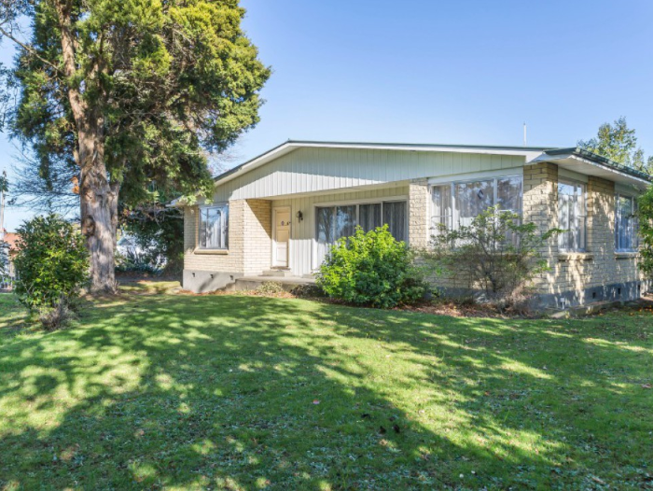
Haere Mai ki Tō Tātau Kāinga
SAMPLE IMAGE
right click to replace
Include a photo of the home or family in the box above.

Slide 2
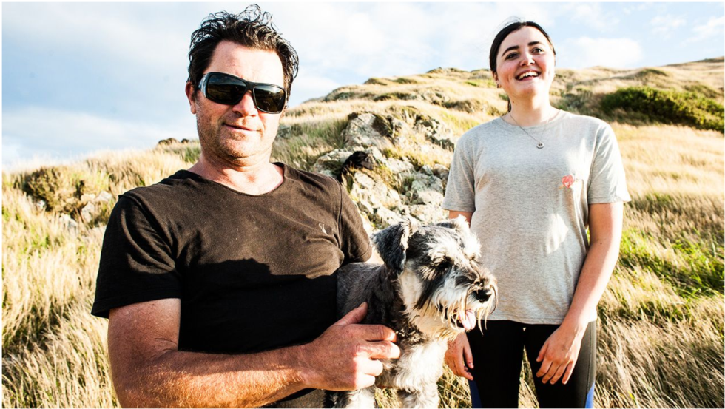
He Rawe te Tūtaki atu ki a Koe!
SAMPLE IMAGE
right click to replace
Include a photo of the caregivers in the box above.
In this box, include a short blurb about each of the caregivers: name, occupation, interests, how long they have been caregivers for (if applicable).
Culture: What is the culture of the home? And how may this play a role in the way the family lives?
Language: What language is spoken in the home? Include the caregivers feelings about the new placement. “We can’t wait to meet you and are happy to have you in our family.”
Tip: One of the most common questions coming from tamariki who have been in care has been ‘Are they kind?’. If this can be conveyed in this section, it could greatly put the child’s mind at ease.

Slide 3
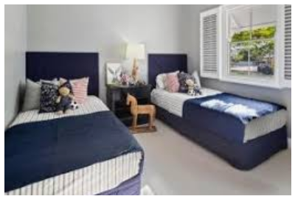
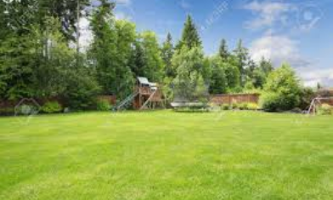
Ko Tō Tātau Kāinga
The purpose of this section is to describe the physical environment. Some commonly asked questions by tamariki are:
Will I get my own room?
Will I be able to store my belongings somewhere?
Is there somewhere I can go to be alone?
Is there an upstairs?
Is it warm? Is it clean and dry?
*Prompts around disability – e.g. if there are wheelchair ramps
IMPORTANT TO INCLUDE: Tamariki want to know whether the home and community is safe. Emphasise any elements of safety that the home will provide, e.g. the house is back from the road, quiet at night-time, friendly neighbours.
In the photo boxes below, include a photo of the home or the child’s room or any other relevant photos.
SAMPLE IMAGE
right click to replace
SAMPLE IMAGE
right click to replace

Slide 4
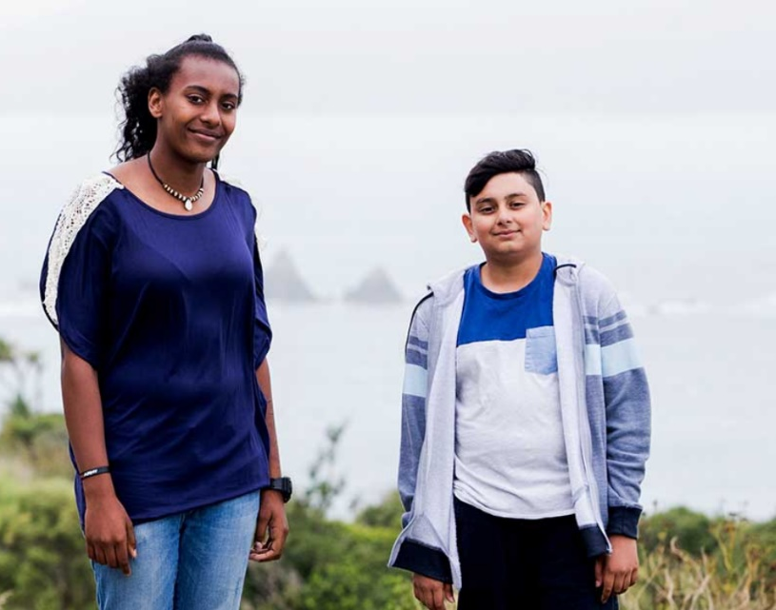
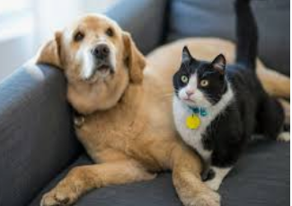
Ko Wai Mā ka Noho ki Konei?
For each other person living in the home (besides the caregivers), include:
First name
Age & gender
their relationship to the caregiver
Their interests, sports, hobbies (optional)
Personality traits (optional)
Remember to include any pets!
In the boxes below, insert a photo of each person living in the home. Remember to check that the caregiver has asked their permission.
SAMPLE IMAGE
right click to replace
SAMPLE IMAGE
right click to replace
Name of the people in the box above
Name of the people (pets!) in the box above

Slide 5
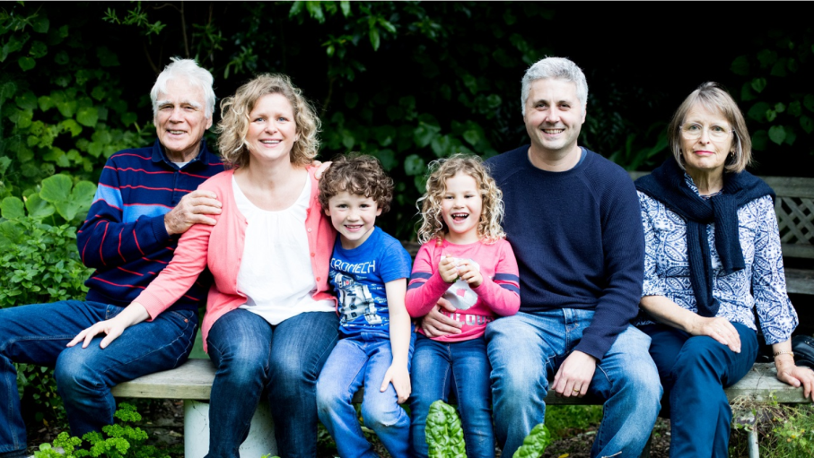
Ko Ā Tātau Manuhiri
Only include this section if it’s relevant.
For each person who frequently visits the home, include:
First name
Age & gender
What is their relationship to the caregiver?
How often they come over?
How long do they usually stay?
Also, include, will the child be allowed to have their friends over?
In the box below, include photo of any regular visitors. Remember to check that the caregiver has asked their permission.
SAMPLE IMAGE
right click to replace

Slide 6
Ko ngā Hātepe o te Whānau
This section is where to add the information about the day to day life in the household. Suggested content based on tamariki insights are:
Routines
What regular activities does the family do? Suggested examples:
Here’s how we get ready in the morning (list the routine, especially who will take the child to school)
We go to Church each week, you can come too if you like, but you don’t have to. Or, alternately there are churches nearby, if you’d like to go, we are happy to take you or support you.
We leave a light on in the hallway each night
The pets sleep outside
Mealtimes - We eat dinner at the table each night, you may want to include here what kinds of food does the family like to eat? E.g. we love to get fish and chips on a Friday night. If you like cooking, you can help or cook a meal for us.
The Way We Do Things:
E.g. we get our chores finished before any screen time is allowed
For teens, include curfews, discipline, levels of independence they will have

Slide 7
Ka aha:
This section is to help alleviate any of the child’s fears, this can be tailored based on the child’s age but some suggested sections are:
If I have an accident?
e.g. It’s not a problem, just come let us know and we can remake the bed. We have lots of clean sheets!
If I have hurt myself or I’m worried about something that’s happened?
- e.g. Come and tell us, no matter how it’s happened we will sort it out.
If I do something that is not ok or causes concern?
- e.g. We will talk to you about it and work out why it happened together by talking, not by yelling or getting angry.
If I get hungry?
- e.g. Just ask and we can get some food together. We always have plenty of food.
If I feel scared at night?
- e.g. It’s ok to feel scared, and it’s normal. You can have nightlight if that helps.
When I miss my family?
e.g. We will always listen if you need to talk, we’re always here for you.
Here are some things we can talk through when you get here:

Slide 8
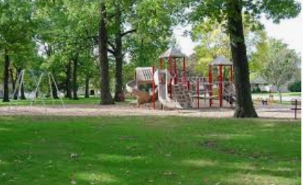
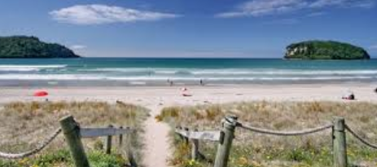
Ko ngā Mahi Whakangahau!
Include in here what the family likes to do for fun, or what activities there are to do in the house or in the neighbourhood.
Are there toys to play with?
Is there a garden?
Information on the neighbourhood:
What is the neighbourhood like (without disclosing the location),i.e. there is a park across the road with a slide, near the marae, pool, library, river, etc)
Kids want to know, ‘Will I get to have screen time? Is there Wi-Fi?’
In the below boxes, include photos of the fun things mentioned, e.g. nearby park, toys, garden or any other relevant photos.
SAMPLE IMAGE
right click to replace
SAMPLE IMAGE
right click to replace

Slide 9
Ngā Whakaaro, Pātai rānei?
Here is a space for you to write down any questions or things you want to remember to talk about. This can be a drawing or a list, whatever you like!

